Slide 1
Project Overview
In this project we will use the emerging iot technologies to build a web application which will allow the framer to get real time data such as temperature and humidity of his field
.It will also provide the farmer weather forecasting data around his area .He will also be able to control
his motors from the web application

Slide 2
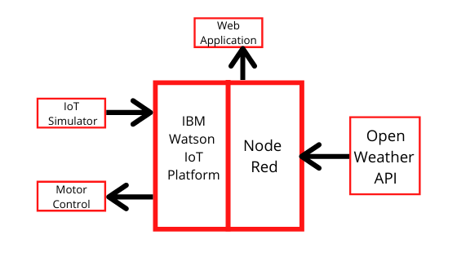
BLOCK DIAGRAM

Slide 3
Smart Agriculture using IOT Technologies
Made by :-Prinka Raina
Application ID:-SPS_APL_20200002744
Project ID:-SPS_PRO_101
Email:-prinka18@gmail.com

Slide 4
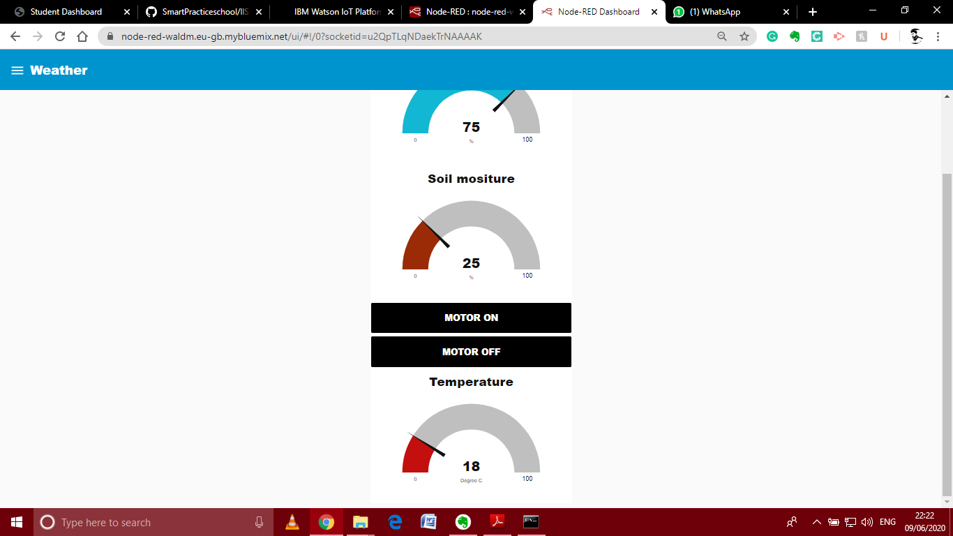

Slide 5
